Slide 1

COMP-10065
Web Scripting
Part 1: PHP

Slide 2

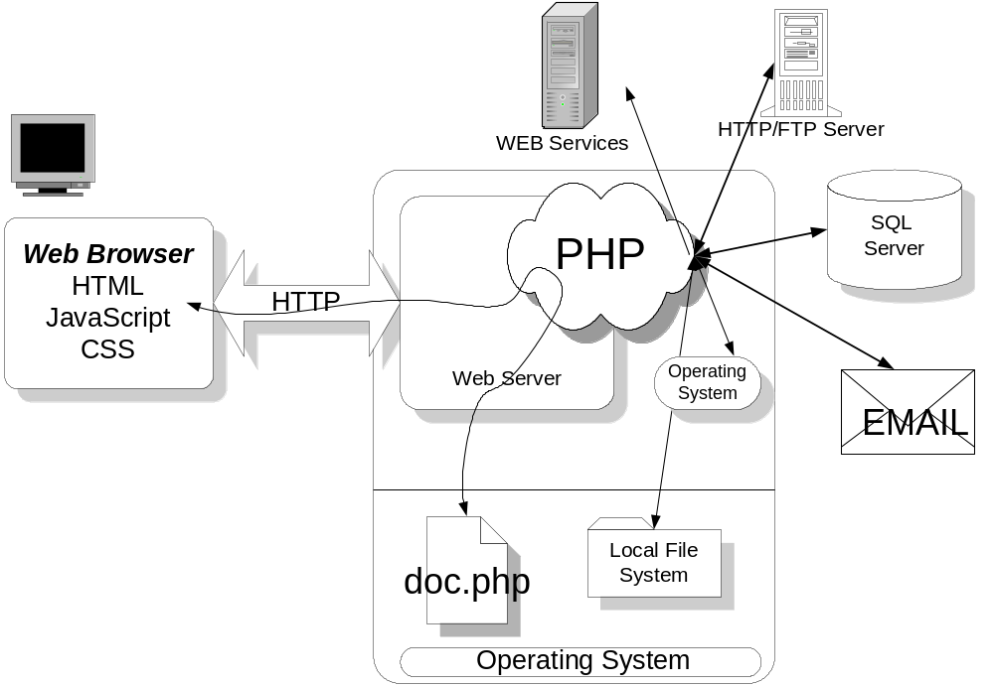
What is ?

Slide 3
What is PHP?
PHP is a tool that lets you create dynamic web pages
PHP is the middle tier of a 3 tier Web System
  Tier 1 is the client browser
    HTML, JavaScript and CSS
  Tier 2 is the application server
    HTTP, Web server and PHP Script Interpreter
  Tier 3 are remote network services
    SQL servers, HTTP servers, mail servers,directories, etc
PHP is the glue that pulls all these technologies together
PHP is referred to as middleware or as an application server

Slide 4
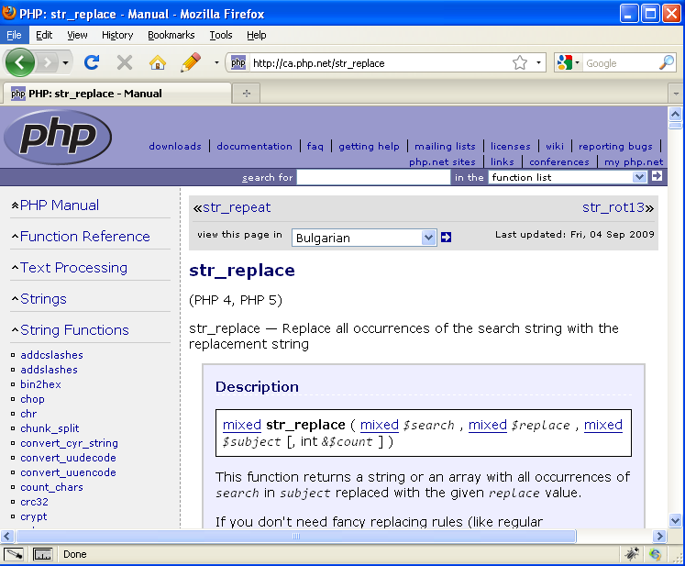
www.php.net
Php.net has a wealth of documentation on PHP
Documentation on all functions,etc can be easily referenced through the site URL
  Ex. To find info on the str_replace function, go to http://www.php.net/str_replace

Slide 5
OverView

Slide 6
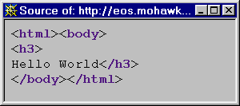
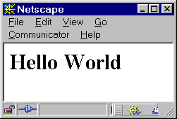
A Simple PHP Program
<html><body>
<h3>
<?
echo "Hello World";
?>
</h3>
</body></html>
helloworld.php
HTML Source
Browser Output

Slide 7
echo( )
The echo() statement outputs a string to the browser.
  since it is a language construct, the parentheses are optional
  preserves white space and text formatting characters
    carriage return and line feeds are passed unaltered
  it is also aliased with print()
Important to keep three views of code in mind
  source view at the server
  html source view at the client end
  browser output as viewed by end user

Slide 8
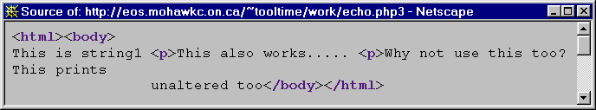
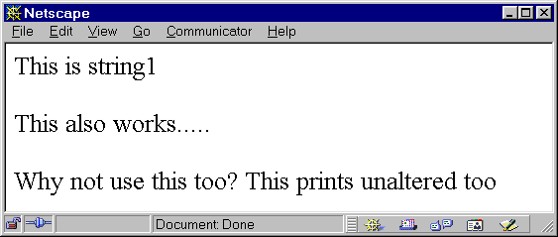
echo() continued
<html><body>
<?
$a = "<p>";
echo ("This is string1 $a");
echo "This also works..... <p>";
echo "Why not use this too? \n";
echo ("This prints
unaltered too");
?>
</body></html>
Source View of
echo.php
HTML generated by echo.php
Output generated by browser

Slide 9
Encapsulating PHP and HTML
PHP code is embedded in an HTML document
Files with .html extension are passed unaltered by server to browser
  no attempt is made to process PHP code in files
Files with .php extension are scanned by web server for embedded PHP code
  server always starts in HTML mode
  enters PHP mode when it encounters a start PHP tag: <?
    it essentially 'escapes' from HTML mode
  server executes PHP code and sends output downstream to browser as part of HTML document
  leaves PHP modes when it encounters end of PHP tag: ?>
Any number of PHP tags can be embedded in your HTML

Slide 10
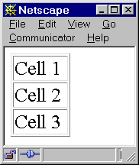
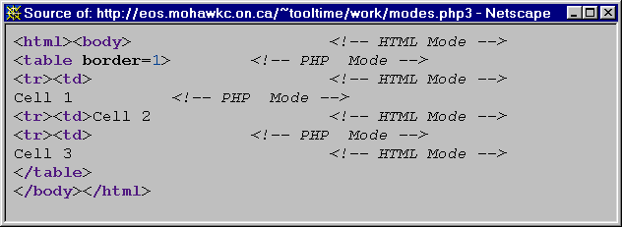
Encapsulating PHP and HTML
<html><body> <!-- HTML Mode -->
<? echo "<table border=1>"; ?> <!-- PHP Mode -->
<tr><td> <!-- HTML Mode -->
<? echo "Cell 1"; ?> <!-- PHP Mode -->
<tr><td>Cell 2 <!-- HTML Mode -->
<? echo "<tr><td>"; ?> <!-- PHP Mode -->
Cell 3 <!-- HTML Mode -->
</table>
</body></html>
Source code on server for modes.php
Output rendered
by browser
HTML source as received by browser

Slide 11
Encapsulating PHP and HTML
There are two sets of PHP tags that can be used for encapsulating PHP code within an HTML document. Configurable at server.
<html>
<? echo("Short Tags: Use this way for course. <P>");?>
<?PHP echo("Preferred Way: Use this way too. <p>");?
</html>

Slide 12
PHP Identifiers
Case SeNsItIvE
Any length of characters
Use only letters, numbers and underscores
First letter must be either letter or underscore
Defined as a regular expression it would be
  '^[a-zA-Z_][a-zA-Z0-9_]*'
Acceptable:
  LastVisit _password comp_Mean a7
Unacceptable:
  Last!Visit ~password comp-mean 7a

Slide 13
Scalar Variables
Variables are represented by a $ followed by the name of the variable
  $name $_name $Name
  $123 $3some email are bad variable names
Variables are dynamically allocated
  no need to define variables as in C
  storage allocated the moment variable is used in script
  variable type can be changed by dynamic re-assignment
Assignment operator is the = sign
Example: $var1 = 5;
$

Slide 14
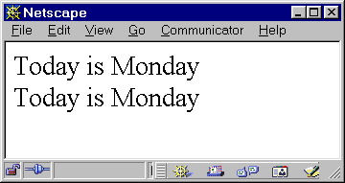
String Variables
String variables are enclosed in "double quotes"
Variables within a double quoted string are expanded
String concatenation performed with ". "operator
<html><body>
<?
$day = "Monday";
echo "Today is $day <br>";
echo "Today " . "is " . $day . "<br>";
?>
</body></html>

Slide 15
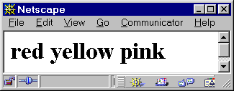
arrays[]
arrays are identified by the [] operator
arrays in PHP are associative (more on this later)
simple arrays have integer keys and values of any data type (int, float,strings,objects)
<html><body>
<?
$color[0] = "red";
$color[1] = "yellow";
$color[2] = "pink";
?>
<h1>
<? echo "$color[0] $color[1] $color[2]"; ?>
</h1>
</body></html>

Slide 16
Control Statements
PHP control statements are very similar in nature to C, C++ and Java
An example of the for loop in action
<html><body>
<?
$color[0] = "red";
$color[1] = "yellow";
$color[2] = "pink";
?>
<h1>
<?
for ($i=0;$i < 3; $i=$i + 1)
echo "$color[$i] ";
?>
</h1>
</body></html>

Slide 17
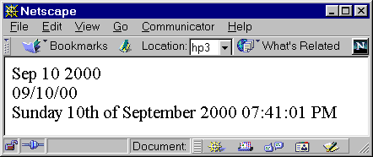
functions()
Functions are identified with the () operators
As in C, they are a named sequence of statements that optionally accept parameters and return a value
Example using the date() function ( a built in function)
<html><body>
<?
echo date("M d Y")."<br>";
echo date("m/d/y")."<br>";
echo date("l dS of F Y h:i:s A");
?>
</body></html>

Slide 18
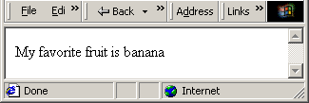
functions()
An example of functions in php
<html><body>
<?
function myfruit($selection)
{
$a[0] = "apple";
$a[1] = "orange";
$a[2] = "banana";
return $a[$selection];
}
echo "My favorite fruit is " . myfruit(2) ;
?>
</body></html>

Slide 19
PHP's Function Library
See PHP's online documentation for a complete list of functions (php.net)
I. Adabas D functions
II. Apache-specific functions
III. Arbitrary precision mathematics functions
IV. Array functions
V. Aspell functions
VI. Calendar functions
VII. ClibPDF functions
VIII. Compression functions
IX. Database (dbm-style) abstraction layer functions
X. Date and Time functions
XI. dBase functions
XII. dbm functions
XIII. Directory functions
XIV. Dynamic Loading functions
XV. Encryption functions
XVI. filePro functions
XVII. Filesystem functions
XVIII. Forms Data Format functions
XIX. FTP functions
XX. Hash functions
XXI. HTTP functions
XXII. Hyperwave functions
XXIII. Image functions
XXIV. IMAP functions
XXV. Informix functions
XXVI. InterBase functions
XXVII. LDAP functions
XXVIII. Mail functions
XXIX. Mathematical functions
XXX. MCAL functions
XXXI. Microsoft SQL Server functions
XXXII. Miscellaneous functions
XXXIII. mSQL functions
XXXIV. MySQL functions
XXXV. Network functions
XXXVI. NIS functions
XXXVII. ODBC functions
XXXVIII. Oracle functions
XXXIX. Oracle 8 functions
XL. PDF functions
XLI. Perl-compatible Regular Expression functions
XLII. PHP options & information
XLIII. POSIX functions
XLIV. PostgreSQL functions
XLV. Program Execution functions
XLVI. GNU Recode functions
XLVII. Regular expression functions
XLVIII. Semaphore and shared memory functions
XLIX. Session handling functions
L. SNMP functions
LI. Solid functions
LII. String functions
LIII. Sybase functions
LIV. URL functions
LV. Variable functions
LVI. Vmailmgr functions
LVII. WDDX functions
LVIII. XML parser functions

Slide 20
Statement Separation
Statements are terminated just as in C or Perl
  each statement must be terminated with a semi-colon.
  white space is ignored
<html>
<h1>Today's Date</h1>
<h3>
<?
$today = date("Y-m-d");
echo "Today is $today";
?>
</h3>
</html>
These two scripts operate identically.
<html><h1>Today's Date</h1><h3>
<? $today = date("Y-m-d");echo "Today is $today"; ?>
</h3></html>

Slide 21
Comments
PHP supports C, C++ and Unix-style comments
  do not nest C-style multi-line comments as they will cause problems.
    /* This is /* not a good */ idea */
<?php
echo "This is a test"; // a one-line c++ style comment
/* This is a multi line comment
yet another line of comment */
echo "This is yet another test";
echo "One Final Test"; # This is unix-style style comment
?>

Slide 22
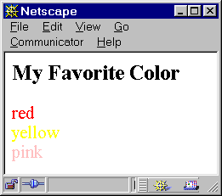
Encapsulating PHP and HTML
This code is written entirely in PHP
All HTML is generated exclusively through echo statements
<?
echo "<html><body>";
echo "<h3>My Favorite Color</h3>";
$color[0] = "red";
$color[1] = "yellow";
$color[2] = "pink";
for ($i=0;$i < 3; $i = $i + 1)
{
echo "<font color = $color[$i]>";
echo " $color[$i] ";
echo "</font><br>\n";
}
echo "</body></html>";
?>

Slide 23
Encapsulating PHP and HTML
This is the same code with HTML and PHP intermixed
Which style do you prefer?
<html><body>
<h3>My Favorite Color</h3>
<?
$color[0] = "red";
$color[1] = "yellow";
$color[2] = "pink";
for ($i=0;$i < 3; $i = $i + 1)
{
?>
<font color = <? echo "$color[$i]";?> >
<?
echo " $color[$i] ";
?>
</font><br>
<?
}
?>
</body></html>

